Slide 1
Solving 2P0 with
Reinforcement Learning
∑
Pratim Chowdhary, Hardik Gupta, Sarah Nam

Slide 2
TABLE OF CONTENTS
01
02
03
04
Background
Implementation
Challenges
Results

Slide 3
01
Background

Slide 4

Hit and Trial - Solving a Payoff Matrix
Basic human technique to grasp task completion.
Example: A puppy sits when owner gives a treat.
Example: Beginning of this class, how did everyone solve the Nim Game? Guess? Learning after seeing outcomes.
Can a machine learning model how to solve a payoff matrix?

Slide 5
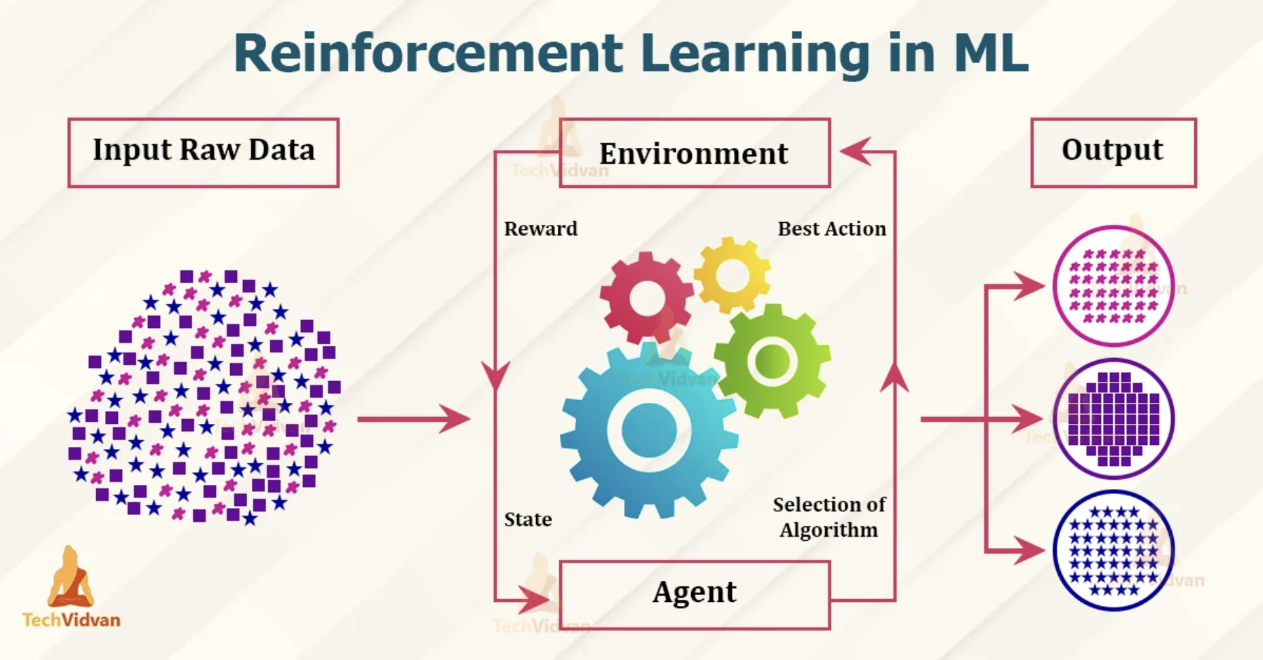
Source: https://techvidvan.com/tutorials/reinforcement-learning/

Slide 6
LinearBrain
Basic Decision-Maker: The LinearBrain is like a simple decision-maker that looks at the situation and decides what to do.
Simple Math Brain: It works by doing basic math calculations to figure out the best action to take.
Scores for Actions: It gives each action a score, and the one with the highest score is the chosen action.
Learning from Experience: It learns from experience; if an action leads to something good, it remembers that for next time.
Good for Simple Tasks: It's great for straightforward tasks like navigating a maze or making simple decisions.
Not for Complex Jobs: However, for really complicated tasks, we might need a more advanced decision-making system.

Slide 7
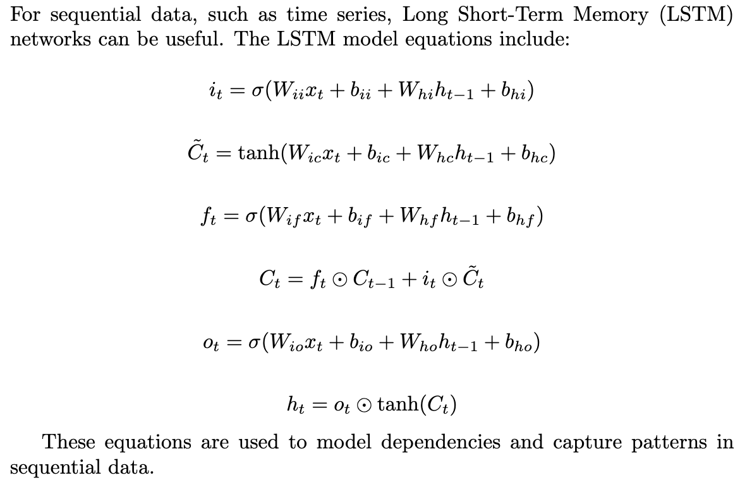
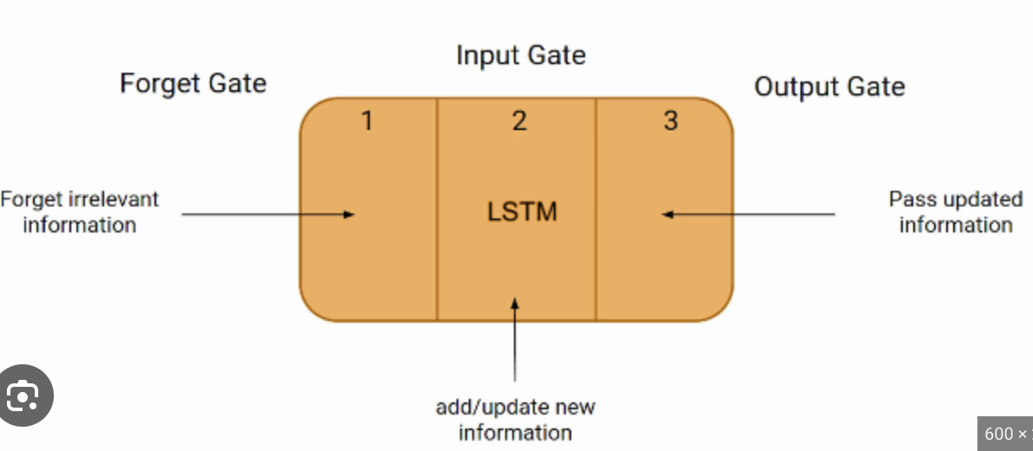
LSTM (Long Short-Term Memory) is a neural network architecture.
Handling Sequences: LSTMs are great for tasks where the order of events matters, like predicting what happens next in a story or time series data.
Avoiding Forgetfulness: Unlike some brains that forget quickly, an LSTM is designed to remember important details over a longer sequence of events.
Great for Time Travel: In a way, an LSTM is like a time traveler, using past information to make predictions about the future.
Handling Long-Term Relationships: LSTMs excel in tasks where understanding the relationship between events that are far apart in time is crucial.

Slide 8
02
Implementation

Slide 9

Code: https://github.com/cpratim/RLGameSolver

Slide 10
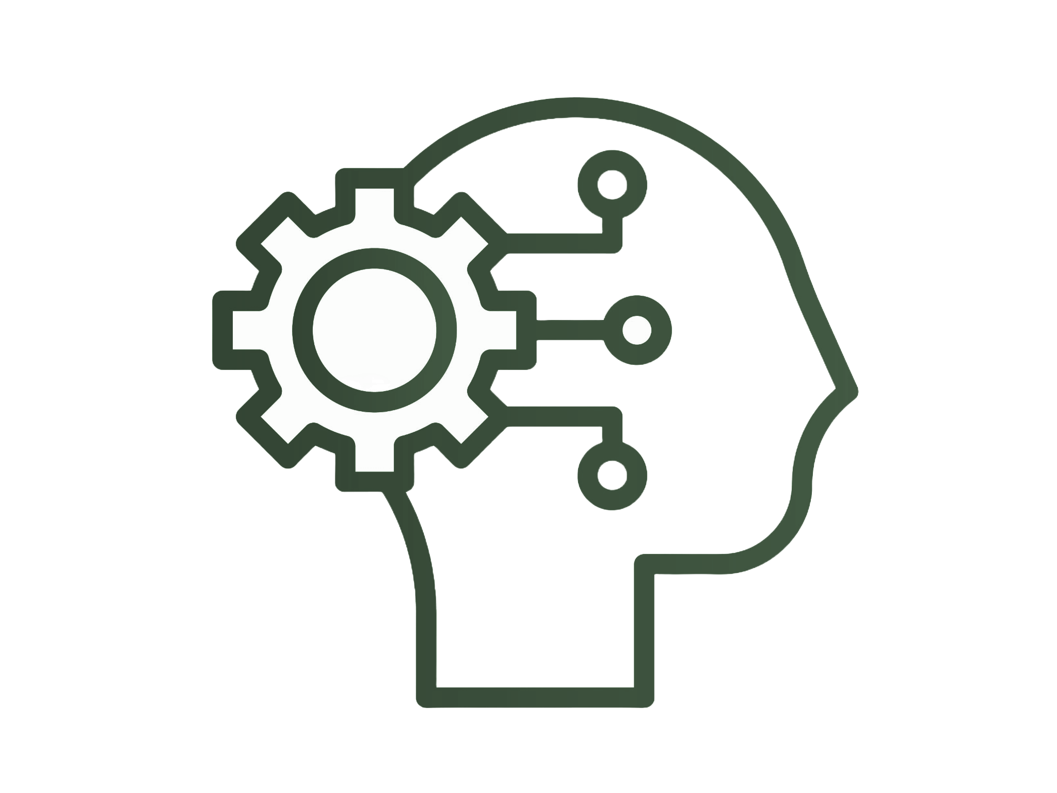

Two Scenarios
Agent 1 v. Agent 2
Agent v. Linear Solver
Two Machine Learning agents play against each other.
One Machine Learning Agent plays against the computer AKA Simplex Algorithm.

Slide 11
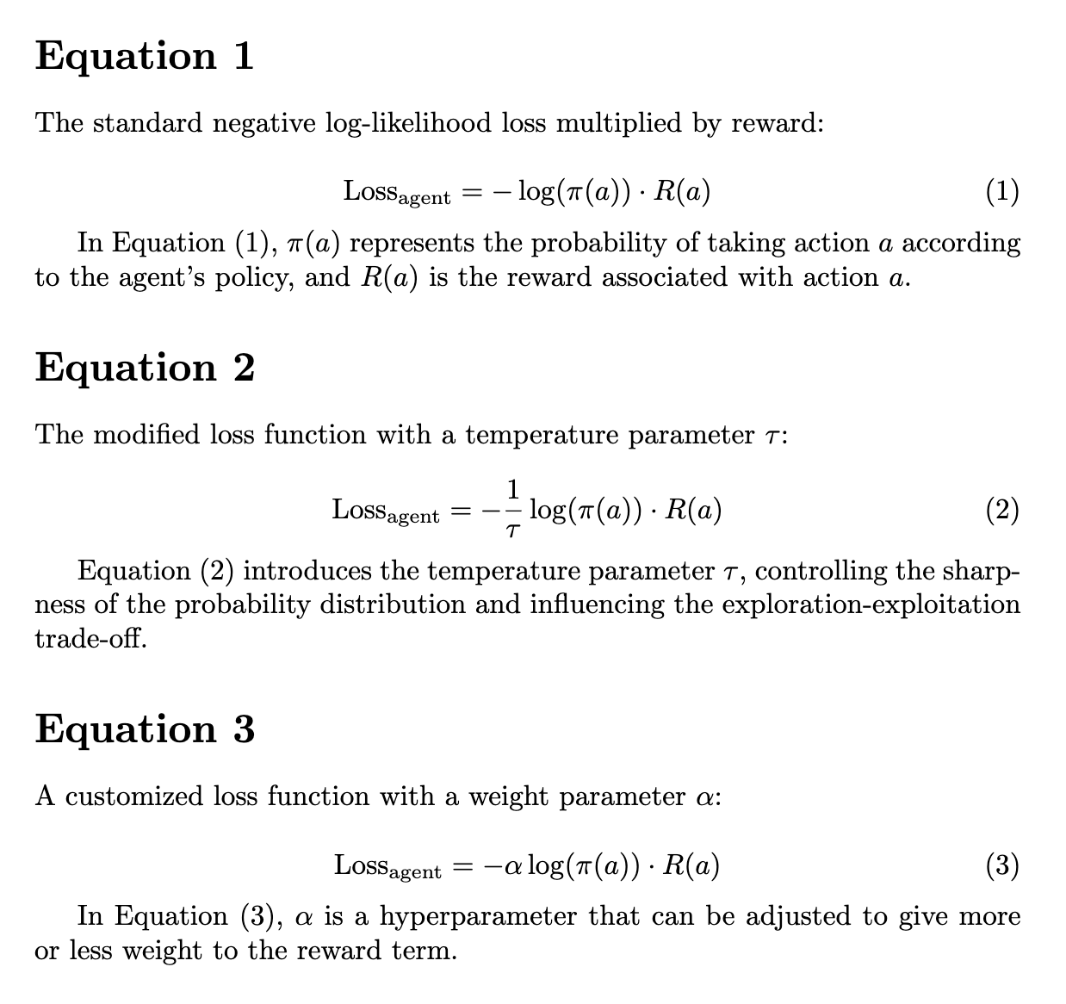
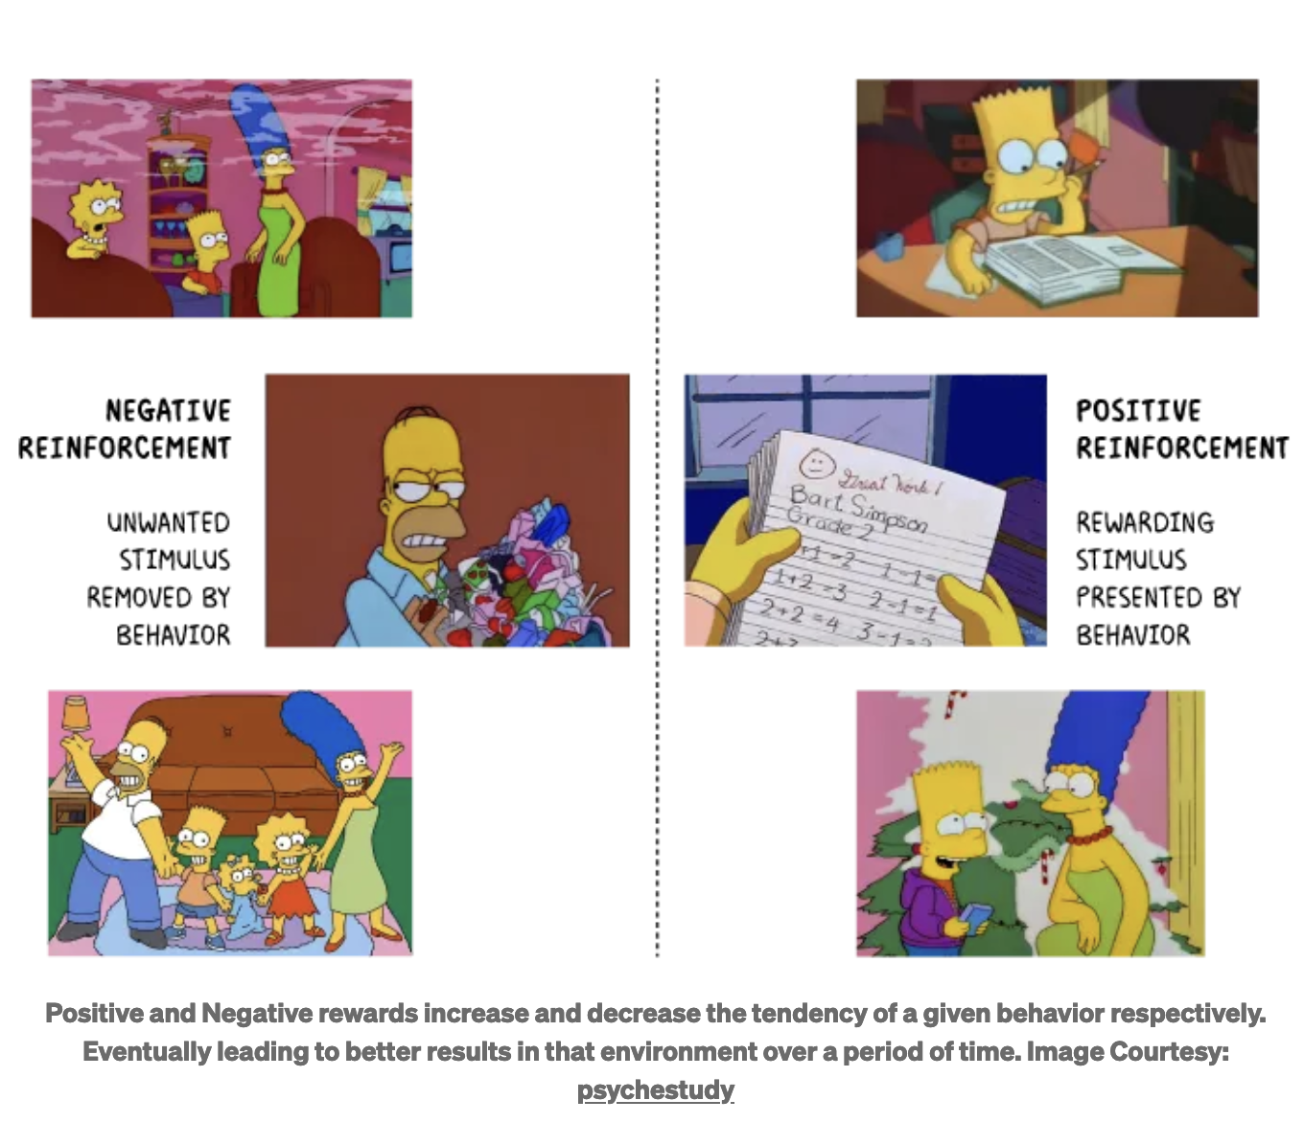
Reward / Loss

Slide 12
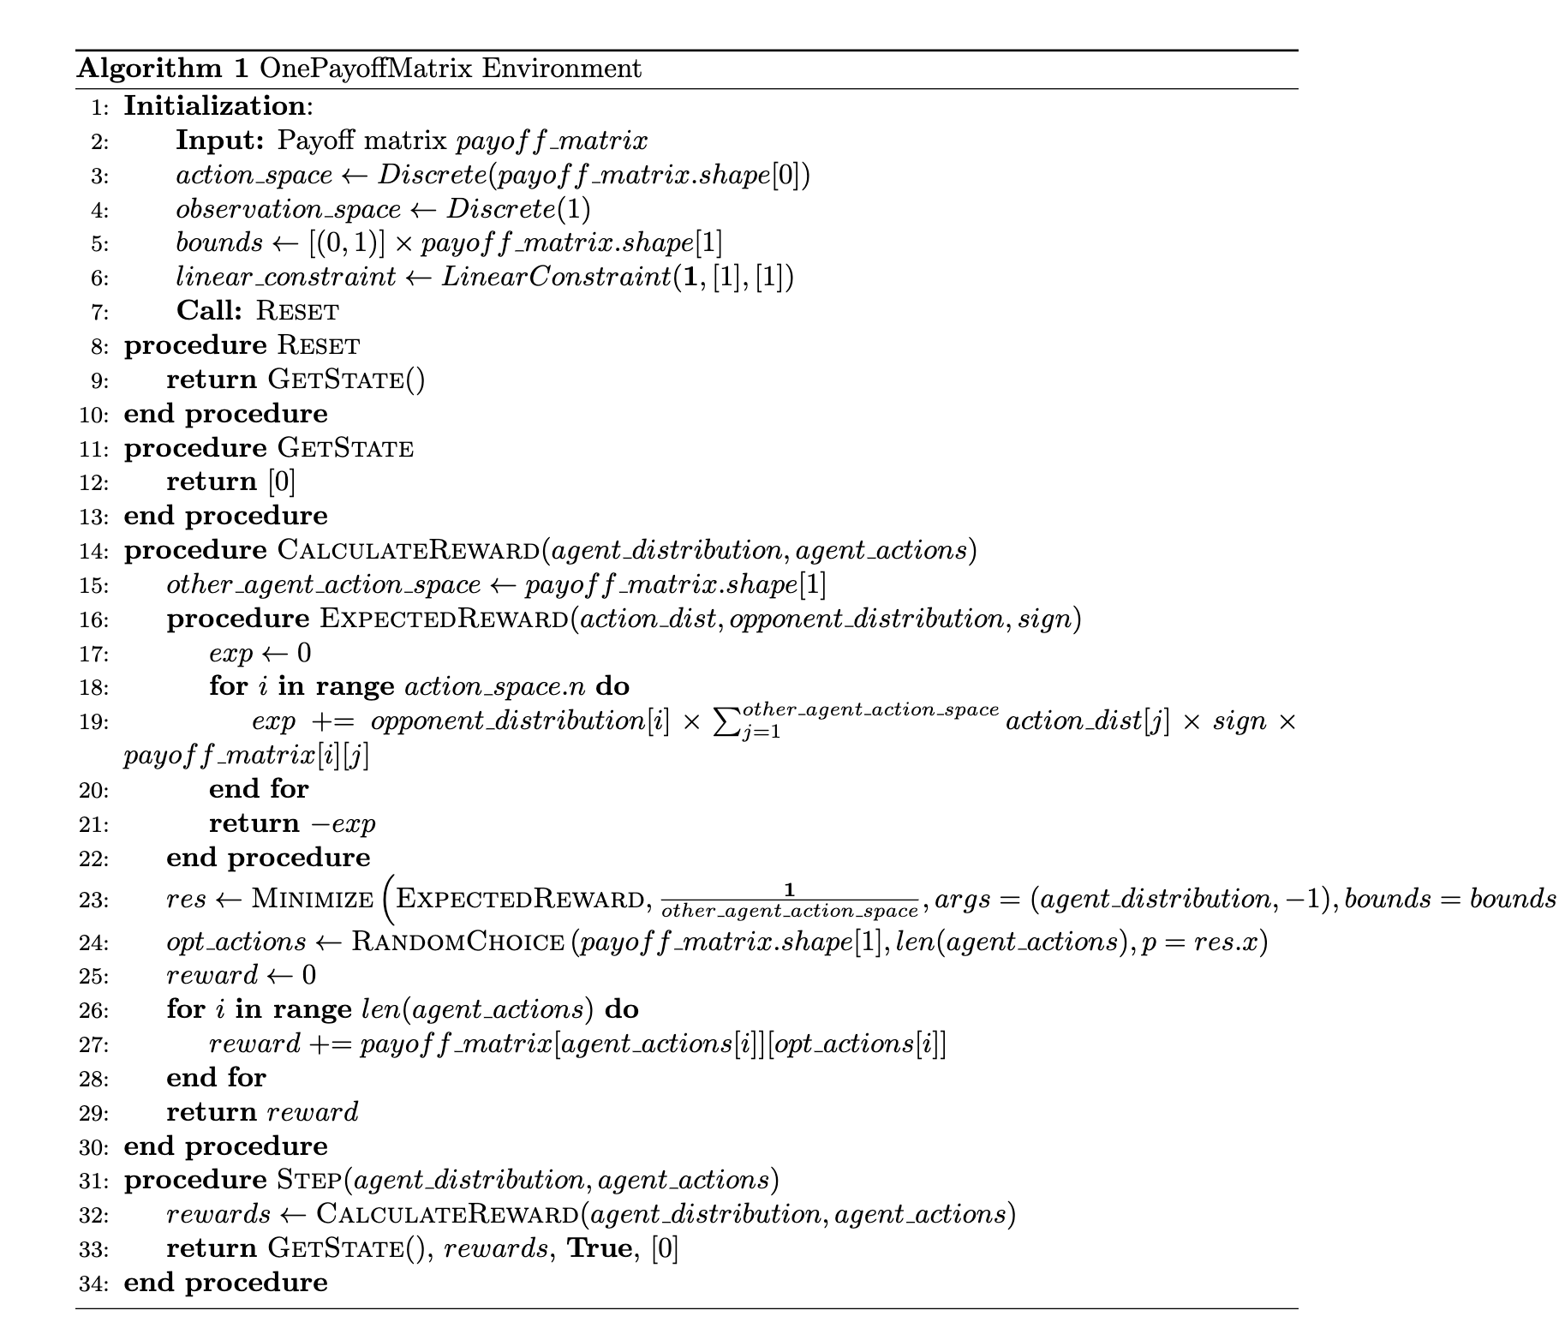
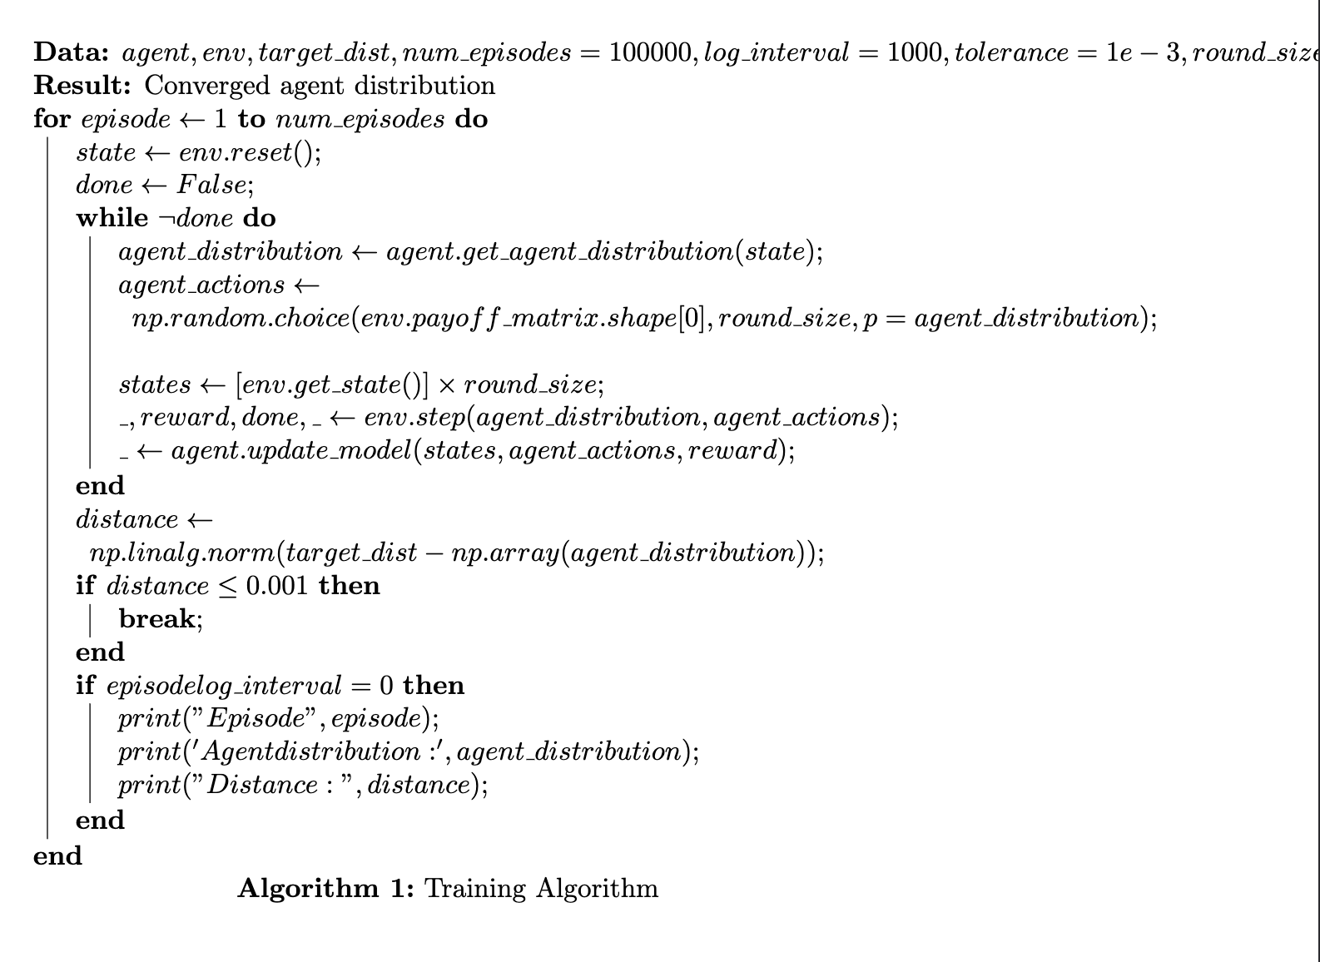
Environment Setup for Agent vs Comp

Slide 13
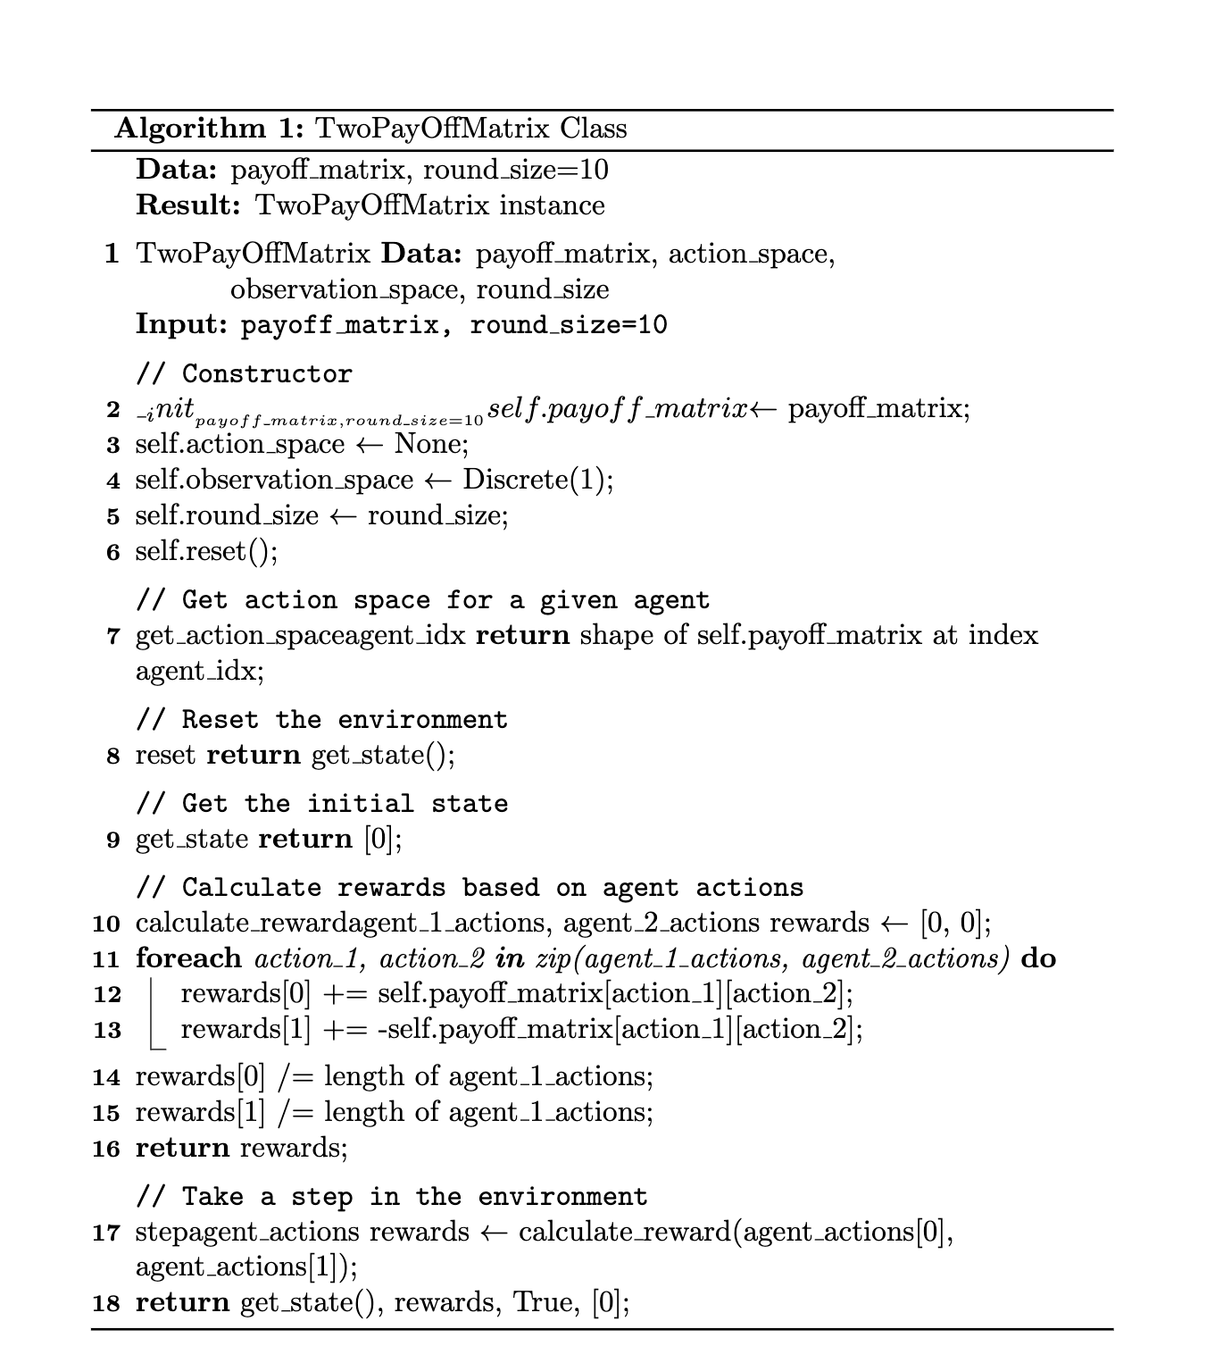
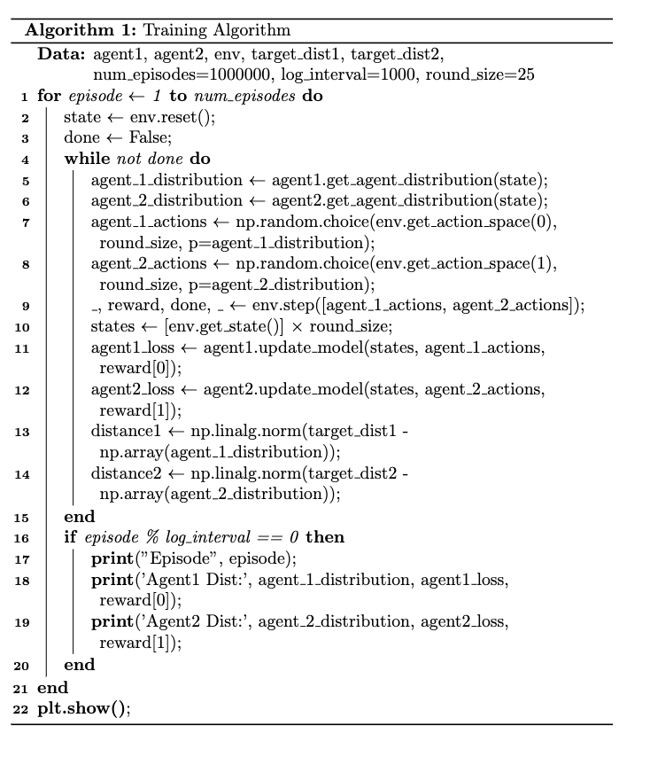
Environment Setup for Agent vs Agent

Slide 14
03
Challenges

Slide 15
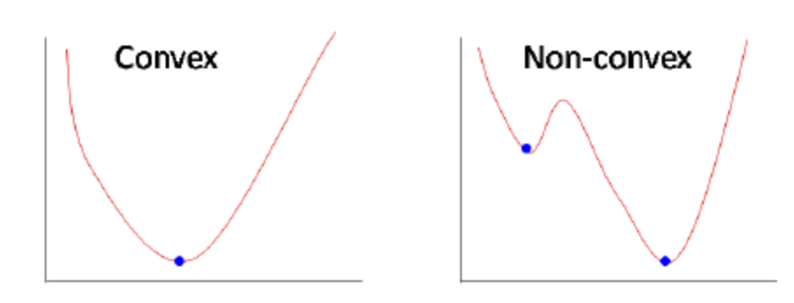
Challenges
Non-Convexity
Dynamic Environments
Complex interaction between agents leads to non-convex optimization.
Difficulty in finding global optima; convergence to local minima affects stability and performance.
Computational Complexity
Exploration

Slide 16
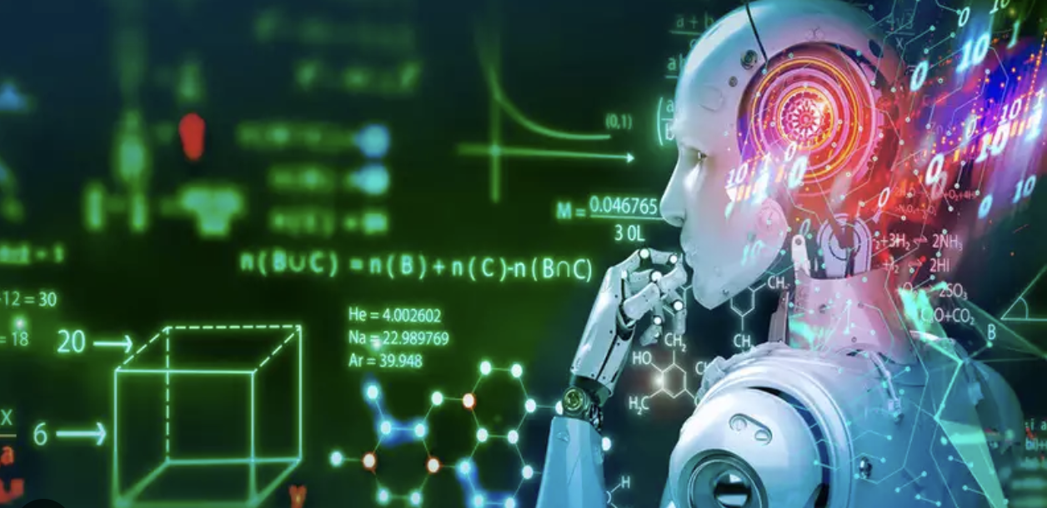
Challenges
Non-Convexity
Dynamic Environments
Games occur in evolving environments with changing optimal strategies.
Agents must adapt to changes, requiring continuous exploration and policy updates.
Computational Complexity
Exploration

Slide 17
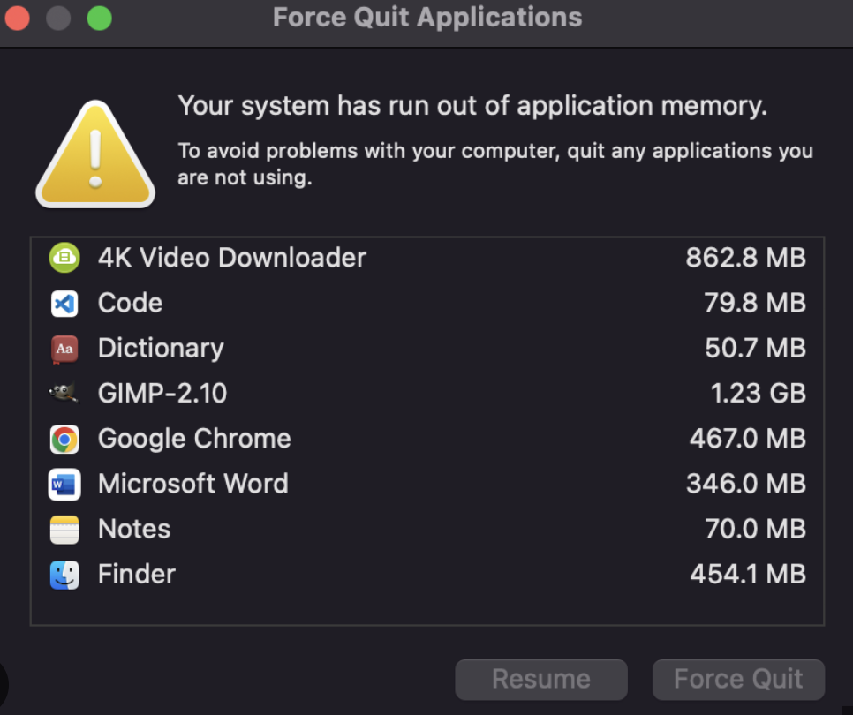
Challenges
Non-Convexity
Dynamic Environments
Computational Complexity
Training demands exploration of a large state-action space.
Optimization process can be computationally expensive, challenging scalability for large and complex games.
Exploration

Slide 18
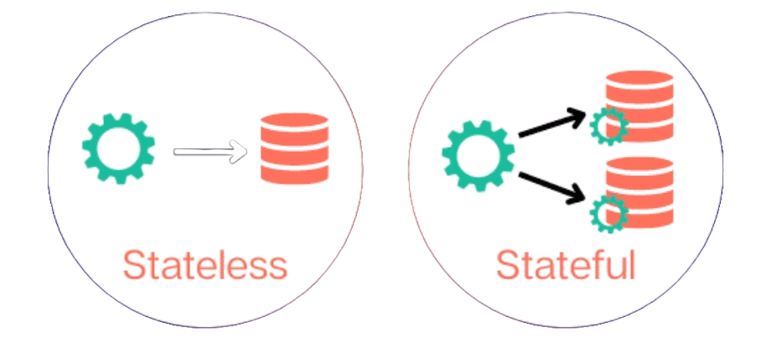
Challenges
Non-Convexity
Dynamic Environments
Games occur in evolving environments with changing optimal strategies.
Agents must adapt to changes, requiring continuous exploration and policy updates.
Computational Complexity
Exploration

Slide 19
04
Results

Slide 20
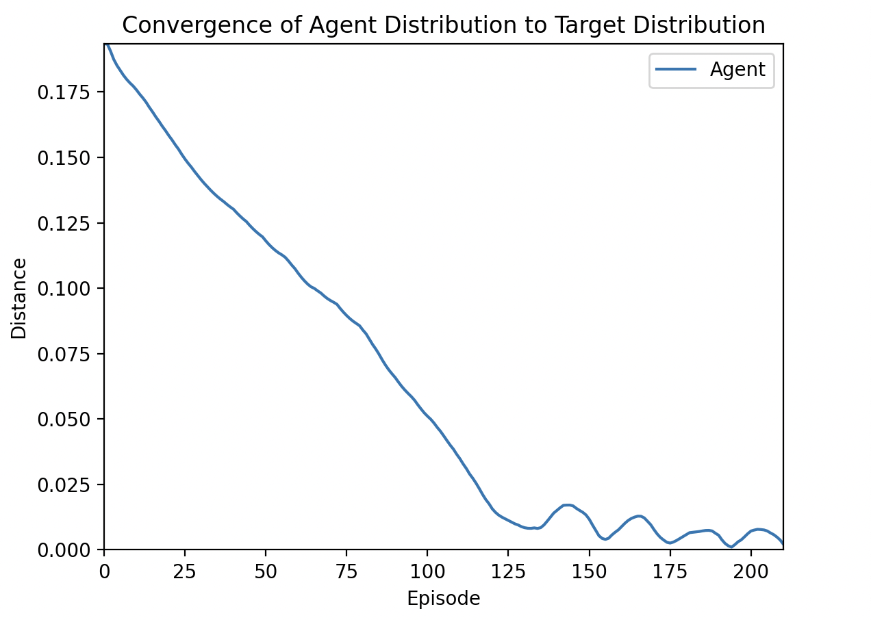
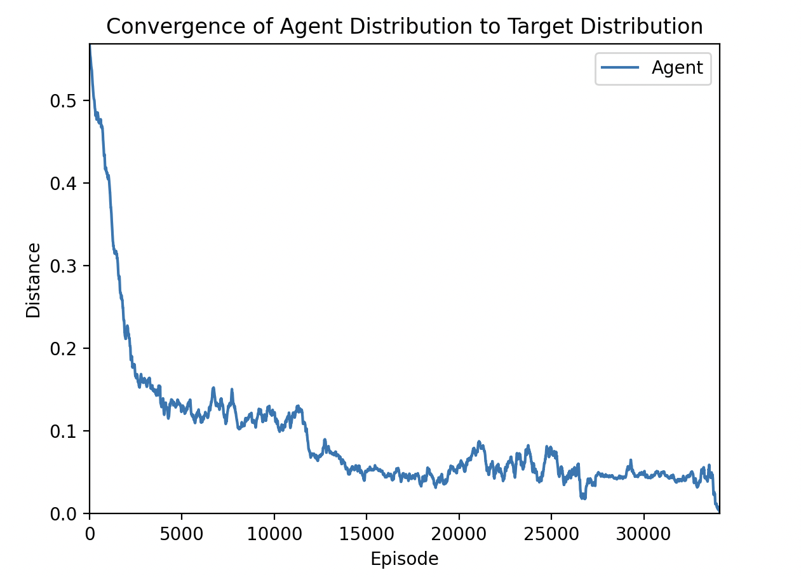
Agent against Linear Solver
Rock, Paper, Scissors
Colonel Blotto

Slide 21
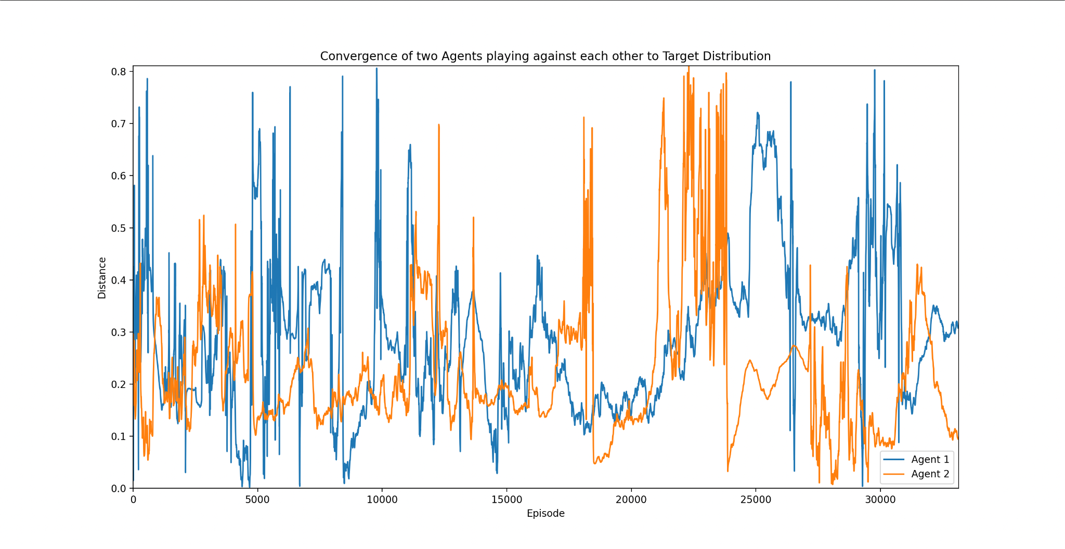
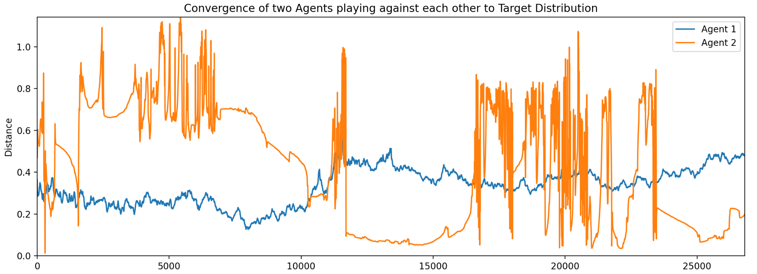
Agent against Agent
Rock, Paper, Scissors
Colonel Blotto

Slide 22
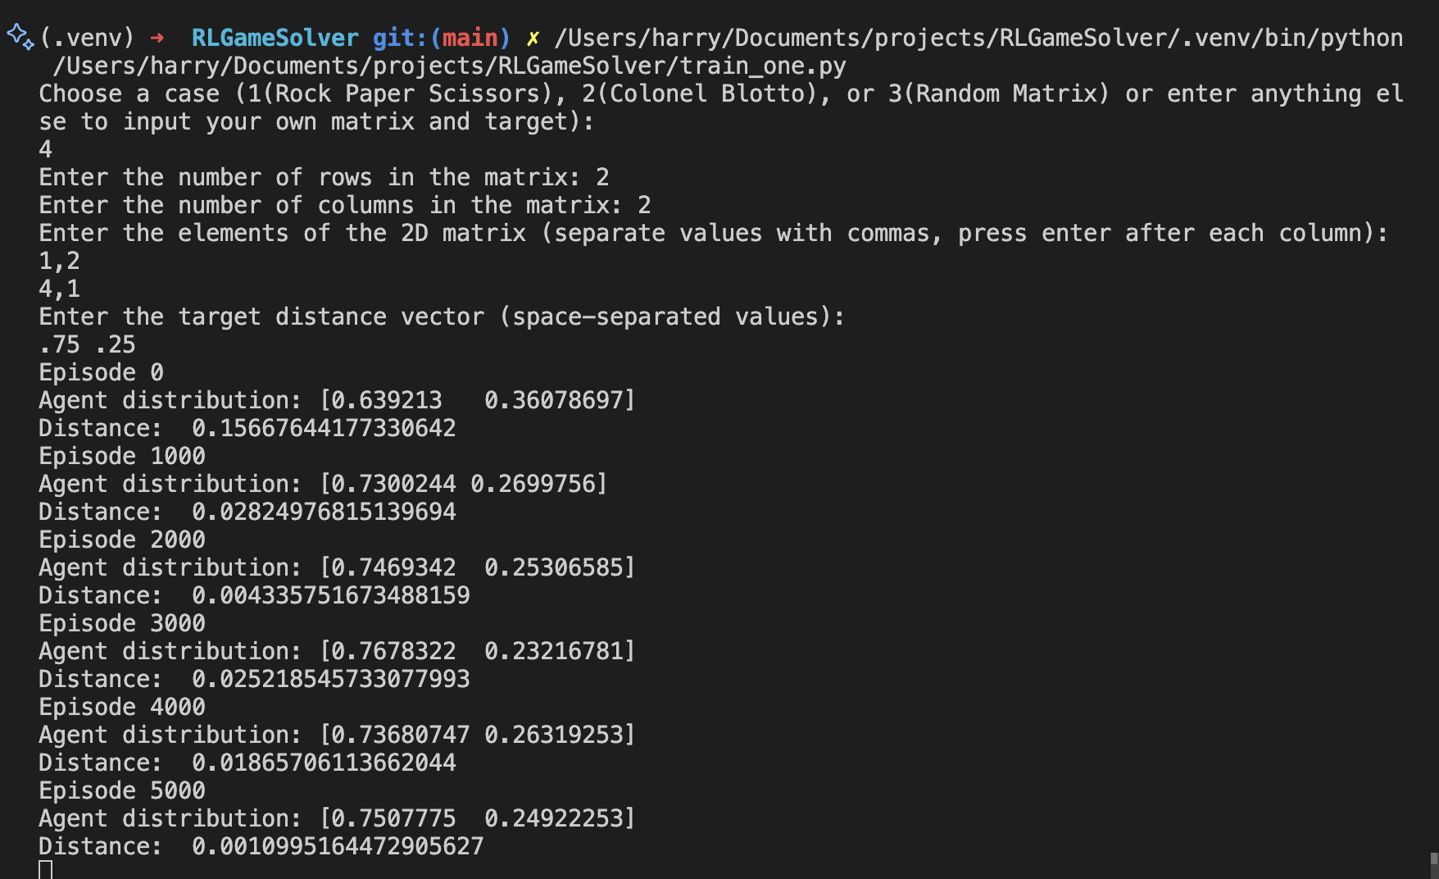
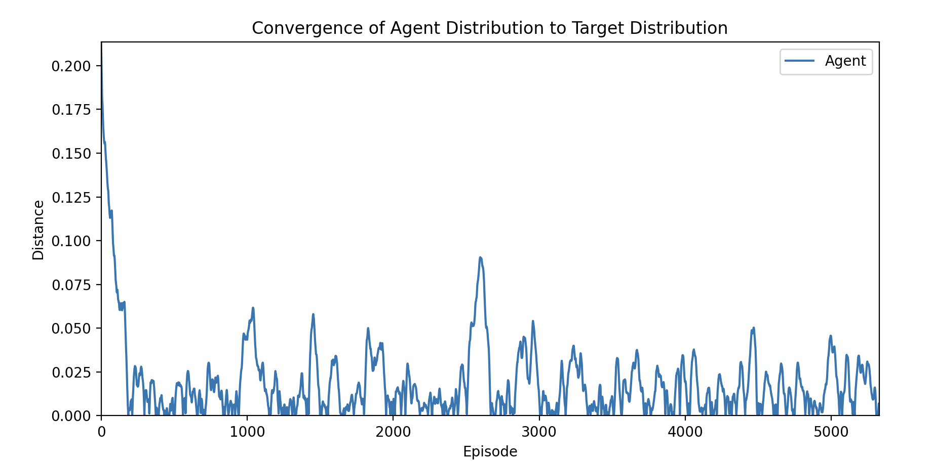
Our model works for a random payoff matrix that a user can provide, to verify the convergence we also provide sample optimal strategy.

Slide 23
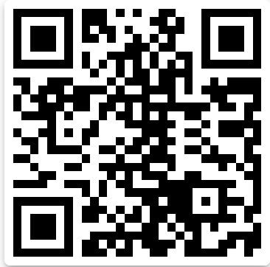

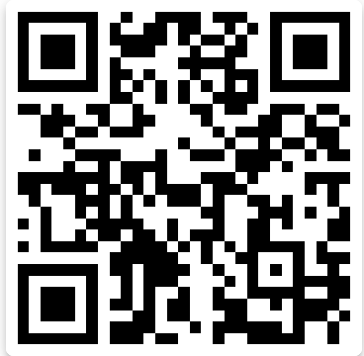
Thank You
Q & A
Pratim Chowdhary
Hardik
Hardik Gupta
Sarah Nam

